Slide 1
Data from iterating through the sine wave output

Slide 2
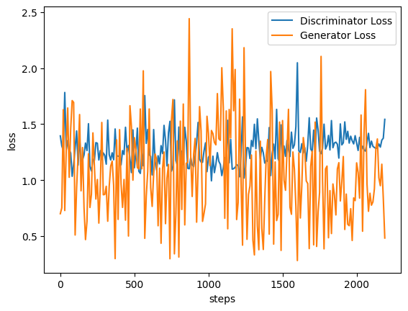
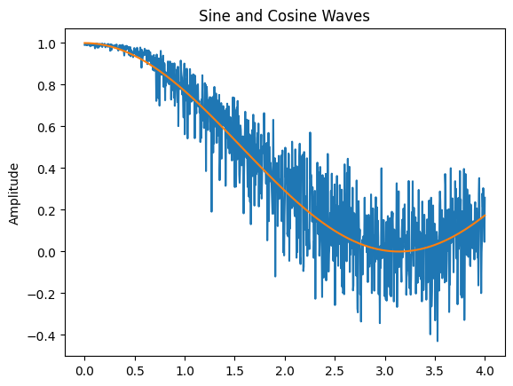
Sine -wave
Containing noise, drop size of network down to 1024 rather than 2094
Lr = 0.0002

Slide 3
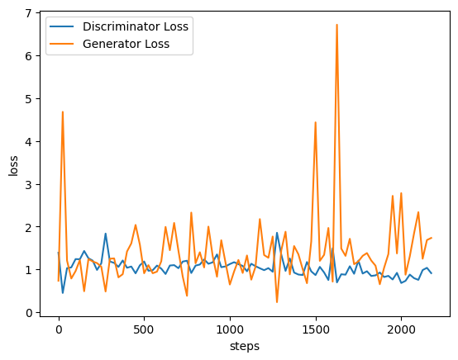
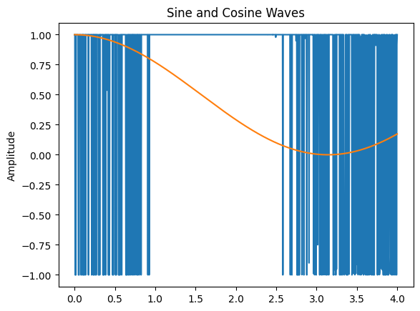
Sine_wave
Containing noise, drop size of network down to 1024 rather than 2094
Lr = 0.0005

Slide 4
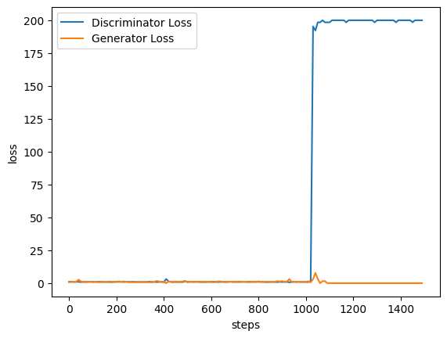
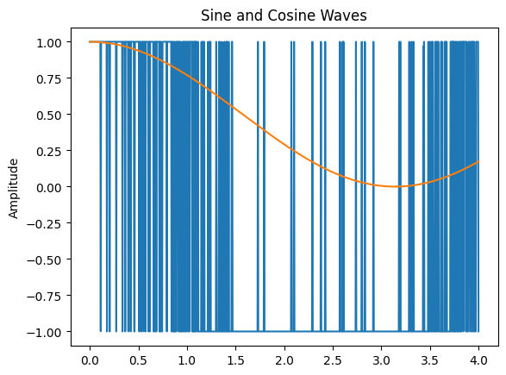
Sine_wave
Noise, large size, batch_size = 64
Lr = 0.00025

Slide 5
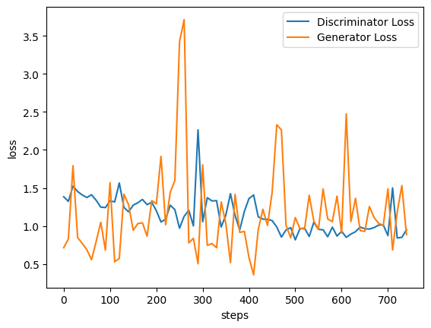
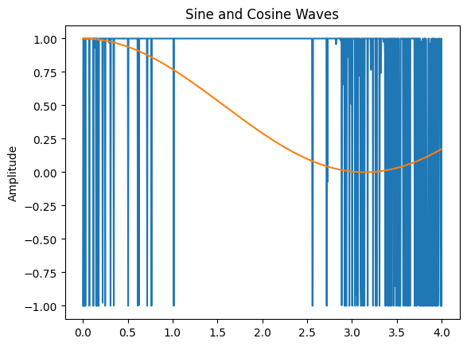
Sine_wave
Full_size, Batch_size = 128, lr = .00015, noise = yes,

Slide 6
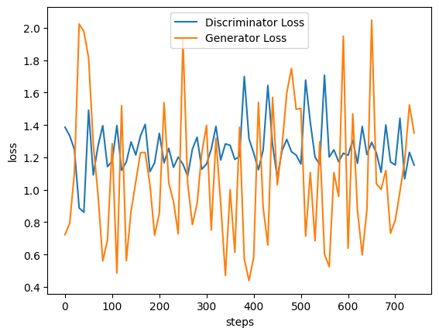
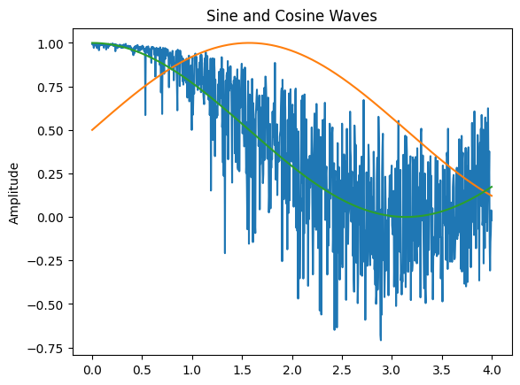
Sine Wave
Lr = 0.0002, noise=yes, max size = 1024, batch_size = 128

Slide 7
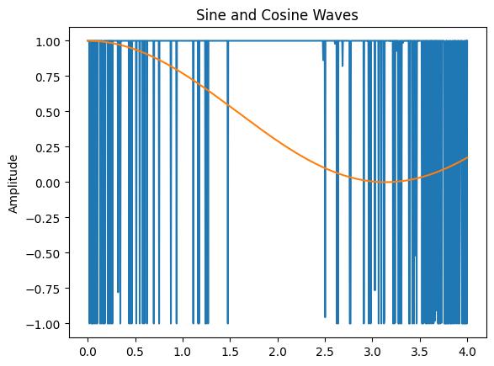
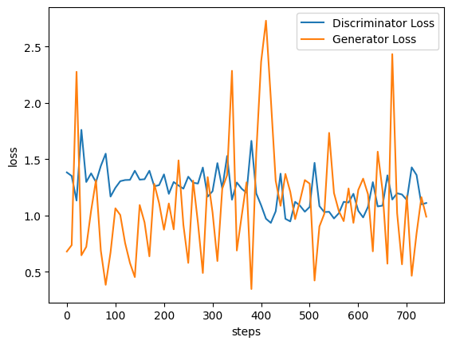
Sine Wave
Lr = 0.0002, batch_size = 128, max size = 2048, noise = yes

Slide 8
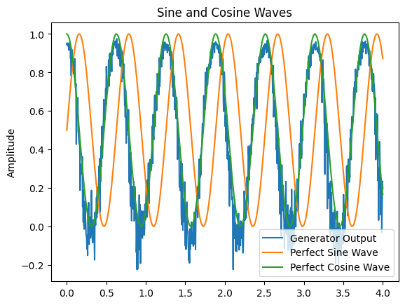
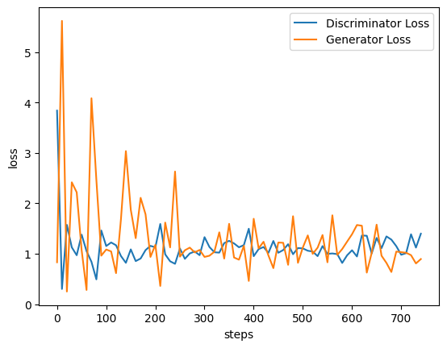
Lr = 0.0002, batch_size = 128, max layer size = 2048, noise = yes, increase the number of features by making Sine wave multiplied by 10

Slide 9
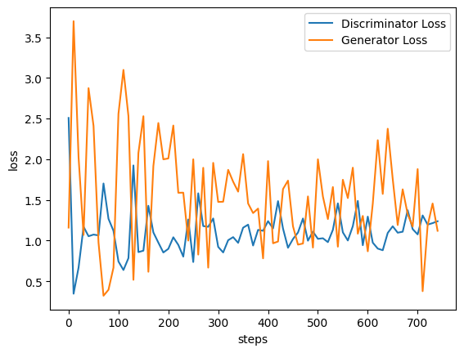
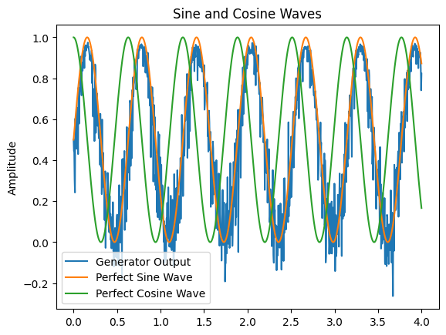
Sine wave more features
Lr = 0.0002, batch_size = 128, max layer size =1024, noise = yes, increase the number of features by making Sine wave multiplied by 10, epochs = 30

Slide 10
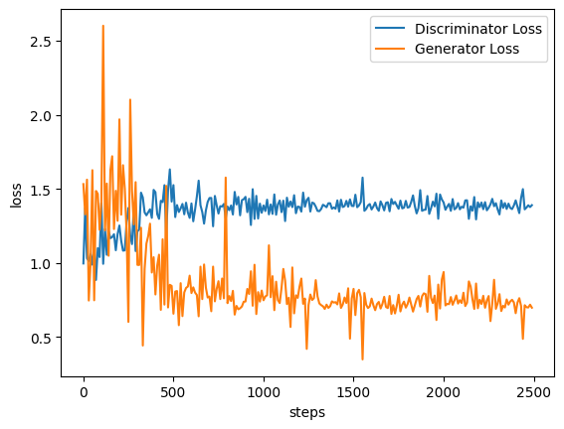
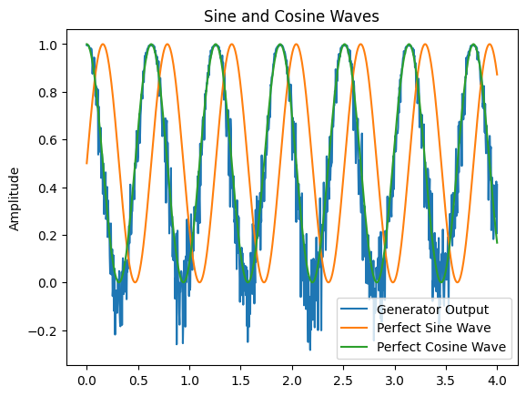
Sine wave more features
Lr = 0.0002, batch_size = 128, max layer size =1024, noise = yes, increase the number of features by making Sine/cosine wave multiplied by 10, epochs = 100

Slide 11
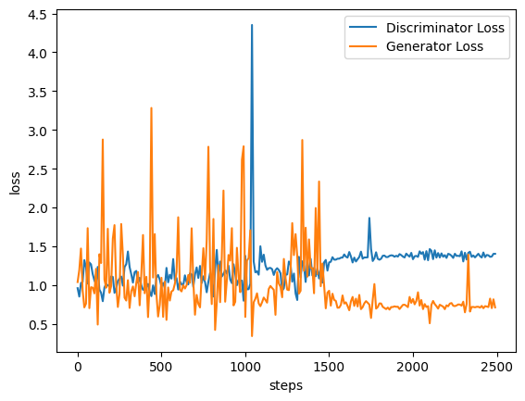
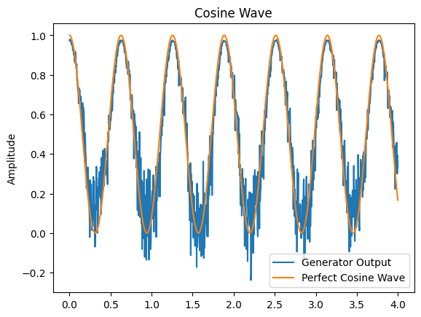
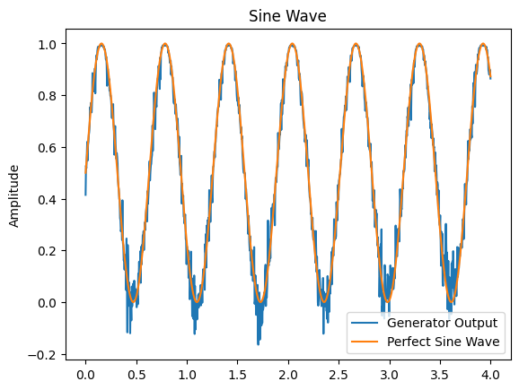
Sine_wave more features
Lr = 0.0002, batch_size = 128, max layer size = 2048, noise = yes, increase the number of features by making Sine/cosine wave multiplied by 10, epochs = 100

Slide 12
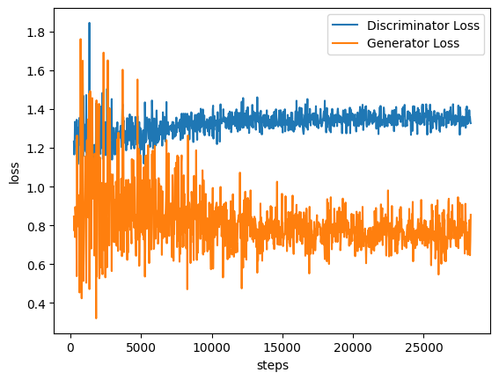
MNIST Example Conditional GAN
Loss function for Conditional GAN on MNIST Data

Slide 13
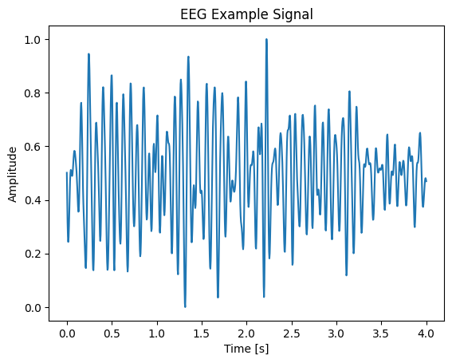
EEG SIGNALS - Generator Output
OG EEG Signal for reference

Slide 14
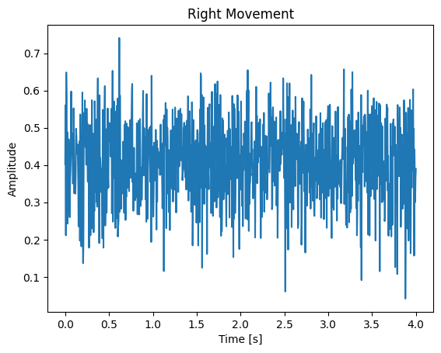
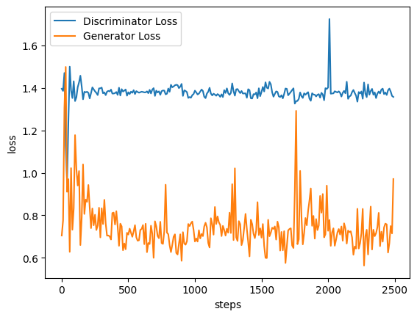
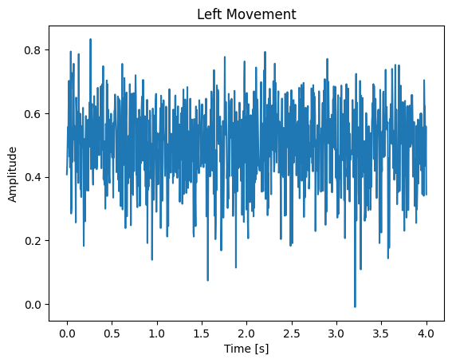
EEG Signal
Batch size = 128, lr = .0002, max net size = 1024, betas = .05, 0.999, epochs = 100

Slide 15
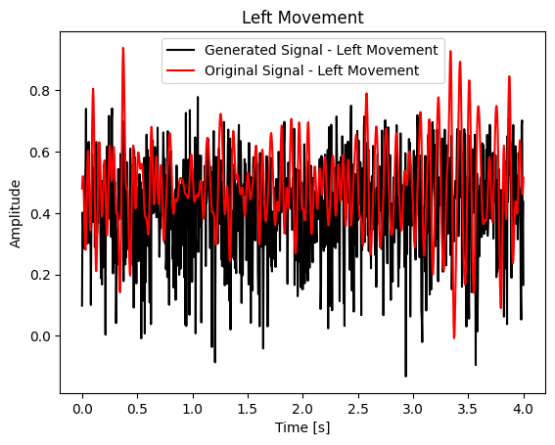
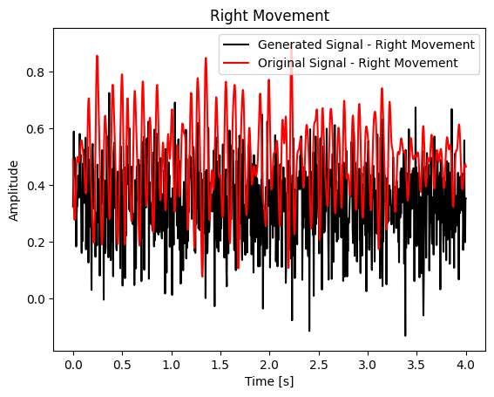
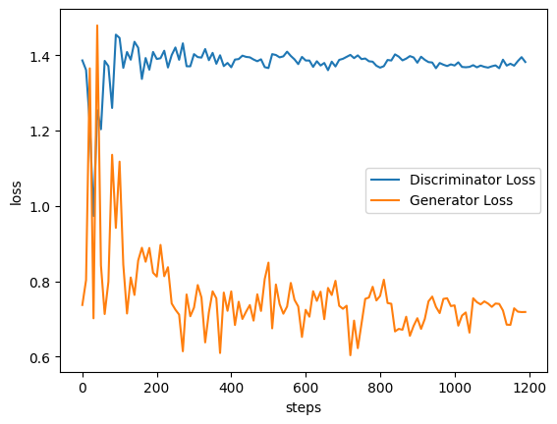
EEG Signal
Batch size = 256, lr = .0002, max net size = 1024, betas = .05, 0.999, epochs = 100

Slide 16
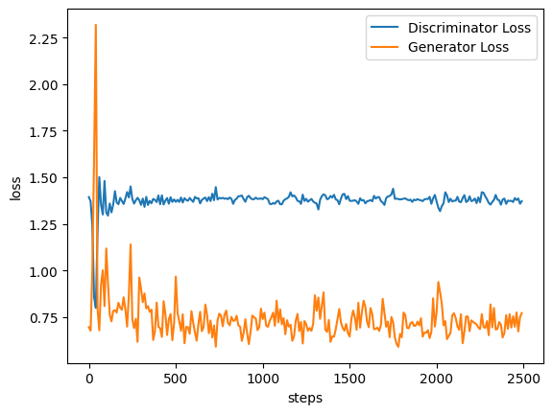
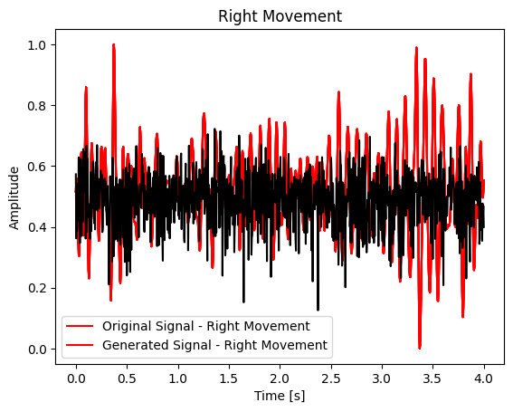
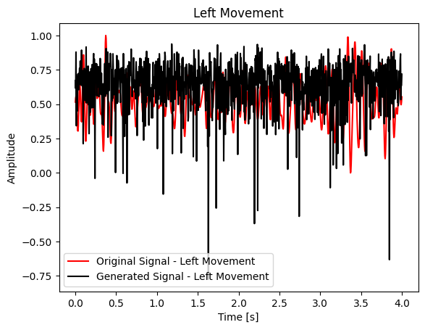
Single EEG signal
Batch: 128, lr = .0002, biggest size = 1024 (tried 2048, exploding gradients),

Slide 17
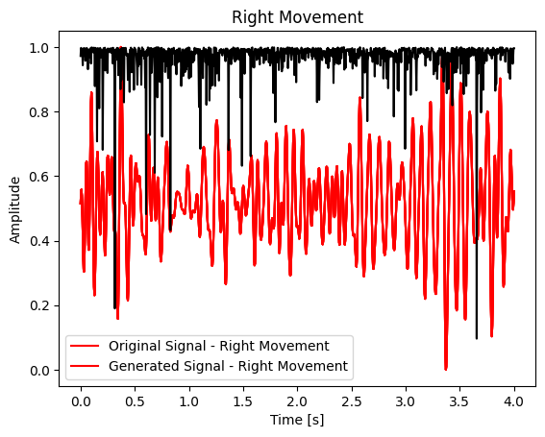
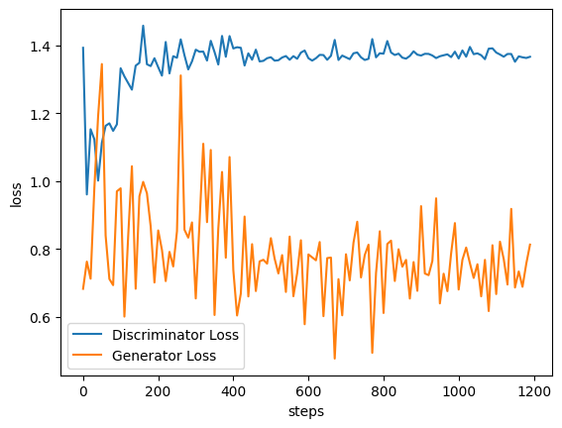
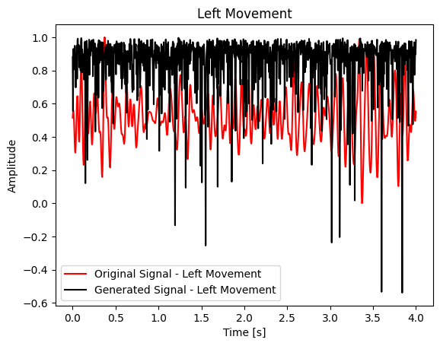
Single EEG
Batch: 256, lr = .0001, sizze = 1024, epoch = 100

